Slide 1
Developing Stored Procedures, DML Triggers and Indexing

Slide 2
Syllabus
Managing Stored Procedures, Create, Alter, Drop, Execute Stored Procedure, Encryption, Passing Data To Stored Procedures, Parameter Default, Returning Data from Stored Procedure, Output Parameter using The Return Statement
Transaction Flow, Creating Triggers, Triggers Limitation, Disabling Trigger. Developing Multi Row Enabled Triggers
Basic Concept of Indexing, Ordered Indices, Type of Indexing, Multiple Key Access, Creating And Dropping Index.

Slide 3
Store Procedure
A stored procedure in SQL is a type of pre-written code that can be stored for later execution and then used many times hence, saving time. It is a group of SQL statements that performs the task. The stored procedure can be invoked explicitly whenever required. It may accept some inputs in the form of parameters, these may be one parameter or multiple parameters.

Slide 4
Benefits of Using a stored procedure
It can easily modified - We can easily modify the code inside the stored procedure without the need to restart or deploying the application.
Reduced network traffic - When we use stored procedures instead of writing T-SQL queries at the application level, only the procedure name is passed over the network instead of the whole T-SQL code.
Reusable - Stored procedures can be executed by multiple users or multiple client applications without the need of writing the code again.
Security - Stored procedures reduce the threat by eliminating direct access to the tables. we can also encrypt the stored procedures while creating them so that source code inside the stored procedure is not visible.
Performance - The SQL Server stored procedure when executed for the first time creates a plan and stores it in the buffer pool so that the plan can be reused when it executes next time.

Slide 5
Creating a stored procedure
We will create a simple stored procedure that joins two tables and returns the result set as shown in the following example:
Example:
CREATE PROCEDURE GetProductDesc
AS
BEGIN
SET NOCOUNT ON
SELECT P.ProductID,P.ProductName,PD.ProductDescription FROM
Product P
INNER JOIN ProductDescription PD ON P.ProductID=PD.ProductID
END

Slide 6
Executing Store procedures
We can use ‘EXEC ProcedureName’ to execute stored procedures.
Example:
EXEC GetProductDesc;

Slide 7
Creating a stored procedure with parameters
Let us create a SQL Server stored procedure that accepts the input parameters and processes the records based on the input parameter.
Example:
CREATE PROCEDURE GetProductDesc_withparameters
(@PID INT)
AS
BEGIN
SET NOCOUNT ON
SELECT P.ProductID,P.ProductName,PD.ProductDescription FROM
Product P
INNER JOIN ProductDescription PD ON P.ProductID=PD.ProductID
WHERE P.ProductID=@PID
END
Executing Command: EXEC GetProductDesc_withparameters 706

Slide 8
Creating a stored procedure with default parameters values
CREATE PROCEDURE GetProductDesc_withDefaultparameters
(@PID INT =706)
AS
BEGIN
SET NOCOUNT ON
SELECT P.ProductID,P.ProductName,PD.ProductDescription FROM
Product P
INNER JOIN ProductDescription PD ON P.ProductID=PD.ProductID
WHERE P.ProductID=@PID
END
Note: When we execute the above procedure without passing the parameter value, the default value 706 will be used. But when executed passing the value, the default value will be ignored and the passed value will be considered as a parameter.

Slide 9
Creating a stored procedure with an output Parameter
Below is the example of a stored procedure with an output parameter. The following example retrieves the EmpID which is an auto identity column when a new employee is inserted.
CREATE TABLE Employee (EmpID int identity(1,1),EmpName varchar(500))
Example:
CREATE PROCEDURE ins_NewEmp_with_outputparamaters
(@Ename varchar(50),
@EId int output)
AS
BEGIN
SET NOCOUNT ON
INSERT INTO Employee (EmpName) VALUES (@Ename)
SELECT @EId= SCOPE_IDENTITY()
END

Slide 10
Creating a stored procedure with an output Parameter (Cont..)
Executing the stored procedures with output parameters is bit different. We must declare the variable to store the value returned by the output parameter.
declare @EmpID INT
EXEC ins_NewEmp_with_outputparamaters 'Andrew', @EmpID OUTPUT
SELECT @EmpID

Slide 11
Creating an encrypted Stored Procedure
We can hide the source code in the stored procedure by creating the procedure with the “ENCRYPTION” option.
CREATE PROCEDURE GetEmployees
WITH ENCRYPTION
AS
BEGIN
SET NOCOUNT ON
SELECT EmpID,EmpName from Employee
END

Slide 12
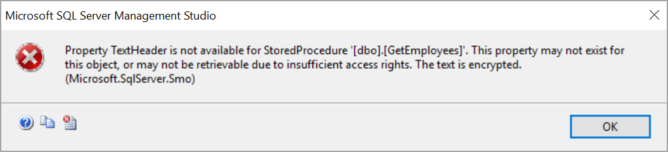
Creating an encrypted Stored Procedure (Cont..)
When we try to view the code of the SQL Server stored procedure using sp_helptext, it returns:
“The text for object ‘GetEmployees’ is encrypted.”
When you try to script the encrypted stored procedure from SQL Server management studio, it throws an error as below.

Slide 13
Creating a temporary Procedure
Like the temporary table, we can create temporary procedures as well. There are two types of temporary procedures,
Local temporary stored procedure
Global temporary stored procedure.
These procedures are created in the tempdb database.

Slide 14
Local temporary SQL Server stored procedures
These are created with # as prefix and can be accessed only in the session where it created. This procedure is automatically dropped when the connection is closed.
Example:
CREATE PROCEDURE #Temp
AS
BEGIN
PRINT 'Local temp procedure'
END

Slide 15
Global temporary SQL Server stored procedure
These procedures are created with ## as prefix and can be accessed on the other sessions as well. This procedure is automatically dropped when the connection which is used to create the procedure is closed.
Example:
CREATE PROCEDURE ##TEMP
AS
BEGIN
PRINT 'Global temp procedure'
END

Slide 16
Modifying the stored procedure
ALTER PROCEDURE statement is used to modify the existing stored procedure.
Example:
ALTER PROCEDURE GetProductDesc
AS
BEGIN
SET NOCOUNT ON
SELECT P.ProductID,P.ProductName,PD.ProductDescription FROM
Product P
INNER JOIN ProductDescription PD ON P.ProductID=PD.ProductID
END

Slide 17
Renaming stored procedure
To rename a stored procedure using T-SQL, use system stored procedure sp_rename.
Example: It renames the procedure “GetProductDesc” to a new name “GetProductDesc_new”.
sp_rename 'GetProductDesc','GetProductDesc_new'

Slide 18
Drop or Delete a SQL Stored Procedure
It deletes the store procedure.
Example:
DROP PROCEDURE GetProductDesc_new

Slide 19
Returning Data from Stored Procedure
Return values can be used within stored procedures to provide the stored procedure execution status to the calling program.
You can create your own parameters that can be passed back to the calling program.
By default, the successful execution of a stored procedure will return 0.

Slide 20
Transaction Flow in Stored Procedures
Transaction refers to the logically connected SQL commands containing the INSERT, UPDATE, SELECT, DELETE statements, and even more.
Transactions differ from an Adhoc SQL statement in a way that they are a group of SQL statements that work in such a way that either all the statements are executed or none of them gets executed and the ones which have been executed gets rolled back, in case an exception occurs.
Transactions follow the ACID properties.
A : A for Atomicity
C : C for Consistency
I : I for Isolation
D : D for Durability

Slide 21
Transaction Flow in Stored Procedures (Cont..)
PROCESS FLOW IN A TRANSACTION
BEGIN TRANSACTION
SQL STATEMENTS
If (error occurs)
ROLLBACK TRANSACTION
Else
COMMIT TRANSACTION

Slide 22
Triggers
Triggers are the SQL statements that are automatically executed when there is any change in the database. The triggers are executed in response to certain events(INSERT, UPDATE or DELETE) in a particular table.
These triggers help in maintaining the integrity of the data by changing the data of the database in a systematic fashion.
Syntax:
create trigger Trigger_name
(before | after)
[insert | update | delete]
on [table_name]
[for each row]
[trigger_body]

Slide 23
Triggers (Cont..)
CREATE TRIGGER: These two keywords specify that a triggered block is going to be declared.
TRIGGER_NAME: It creates or replaces an existing trigger with the Trigger_name. The trigger name should be unique.
BEFORE | AFTER: It specifies when the trigger will be initiated i.e. before the ongoing event or after the ongoing event.
INSERT | UPDATE | DELETE: These are the DML operations and we can use either of them in a given trigger.
ON[TABLE_NAME]: It specifies the name of the table on which the trigger is going to be applied.
FOR EACH ROW: Row-level trigger gets executed when any row value of any column changes.
TRIGGER BODY: It consists of queries that need to be executed when the trigger is called.

Slide 24
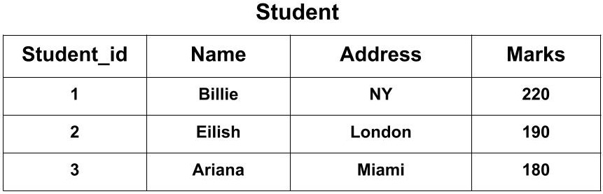
Triggers (Cont..)
Suppose we have a table named Student containing the attributes Student_id, Name, Address, and Marks.
Now, we want to create a trigger that will add 100 marks to each new row of the Marks column whenever a new student is inserted to the table.
The SQL Trigger will be:
CREATE TRIGGER Add_marks BEFORE
INSERT ON Student
FOR EACH ROW
SET new.Marks = new.Marks + 100;
The new keyword refers to the row that is getting affected.

Slide 25
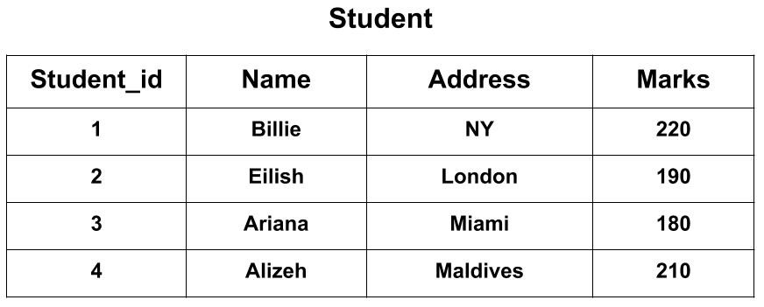
Triggers (Cont..)
After creating the trigger, we will write the query for inserting a new student in the database.
INSERT INTO Student(Name, Address, Marks) VALUES('Alizeh', 'Maldives', 110);
The Student_id column is an auto-increment field and will be generated automatically when a new record is inserted into the table.
To see the final output the query would be: SELECT * FROM Student;

Slide 26
Advantages of Triggers
Forcing security approvals on the table that are present in the database
Triggers provide another way to check the integrity of data
Counteracting invalid exchanges
Triggers handle errors from the database layer
Normally triggers can be useful for inspecting the data changes in tables
Triggers give an alternative way to run scheduled tasks. Using triggers, we don’t have to wait for the scheduled events to run because the triggers are invoked automatically before or after a change is made to the data in a table

Slide 27
Disadvantages of Triggers
Triggers can only provide extended validations, i.e, not all kind validations. For simple validations, you can use the NOT NULL, UNIQUE, CHECK and FOREIGN KEY constraints
Triggers may increase the overhead of the database
Triggers can be difficult to troubleshoot because they execute automatically in the database, which may not invisible to the client applications

Slide 28
Enabling Triggers
We can enable a disabled trigger using the ALTER TRIGGER statement with the ENABLE option.
Example:
ALTER TRIGGER reorder ENABLE;
To enable all triggers defined for a specific table, use the ALTER TABLE statement with the ENABLE ALL TRIGGERS option.
Example:
ALTER TABLE inventory ENABLE ALL TRIGGERS;
Notes:
If there is triggers exist, either it is in enable mode or disable mode.

Slide 29
Disabling Triggers
We can disable a trigger using the ALTER TRIGGER statement with the DISABLE option.
Example:
ALTER TRIGGER reorder DISABLE;
We can disable all triggers associated with a table at the same time using the ALTER TABLE statement with the DISABLE ALL TRIGGERS option.
Example:
ALTER TABLE inventory DISABLE ALL TRIGGERS;

Slide 30
Drop or Delete Trigger
To drop a trigger, the trigger must be in our own schema or we must have the DROP ANY TRIGGER system privilege.
To drop a trigger on DATABASE in another user's schema, We must have the ADMINISTER DATABASE TRIGGER system privilege.
Syntax:
DROP TRIGGER <Trigger_name>;
Example:
DROP TRIGGER Add_marks;

Slide 31
Developing Multi Row Enabled Triggers
Trigger is valid for multirow and single-row inserts.
Examples:
CREATE TRIGGER NewPODetail2
ON Purchasing.PurchaseOrderDetail
AFTER INSERT AS
UPDATE Purchasing.PurchaseOrderHeader
SET SubTotal = SubTotal +
(SELECT SUM(LineTotal)
FROM inserted
WHERE PurchaseOrderHeader.PurchaseOrderID
= inserted.PurchaseOrderID)
WHERE PurchaseOrderHeader.PurchaseOrderID IN
(SELECT PurchaseOrderID FROM inserted);

Slide 32
What is Indexing?
Indexing is a data structure technique which allows you to quickly retrieve records from a database file.
An Index is a small table having only two columns.
The first column comprises a copy of the primary or candidate key of a table.
Its second column contains a set of pointers for holding the address of the disk block where that specific key value stored.
An Index –
Takes a search key as input
Efficiently returns a collection of matching records.

Slide 33
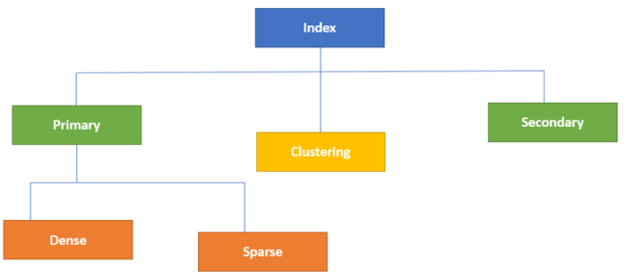
Types of Indexing

Slide 34
Primary Index
Primary Index is an ordered file which is fixed length size with two fields.
The first field is the same a primary key and
second, filed is pointed to that specific data block.
In the primary Index, there is always one to one relationship between the entries in the index table.
The primary Indexing in DBMS is also further divided into two types.
Dense Index
Sparse Index

Slide 35
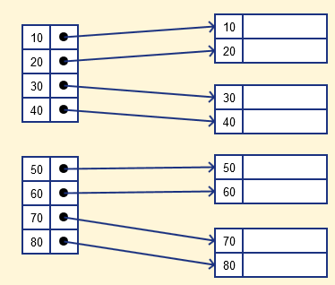
Dense Index
In a dense index, a record is created for every search key valued in the database.
This helps you to search faster but needs more space to store index records.
In this Indexing, method records contain search key value and points to the real record on the disk.

Slide 36
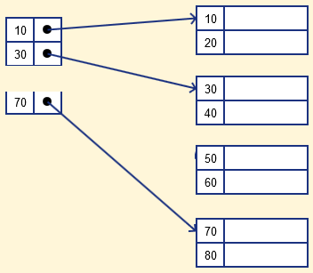
Sparse Index
It is an index record that appears for only some of the values in the file.
Sparse Index helps you to resolve the issues of dense Indexing in DBMS.
In this method of indexing technique, a range of index columns stores the same data block address, and when data needs to be retrieved, the block address will be fetched.
However, sparse Index stores index records for only some search-key values. It needs less space, less maintenance overhead for insertion, and deletions but It is slower compared to the dense Index for locating records.

Slide 37
Secondary Index
The secondary Index in DBMS can be generated by a field which has a unique value for each record, and it should be a candidate key. It is also known as a non-clustering index.
This two-level database indexing technique is used to reduce the mapping size of the first level. For the first level, a large range of numbers is selected because of this; the mapping size always remains small.

Slide 38
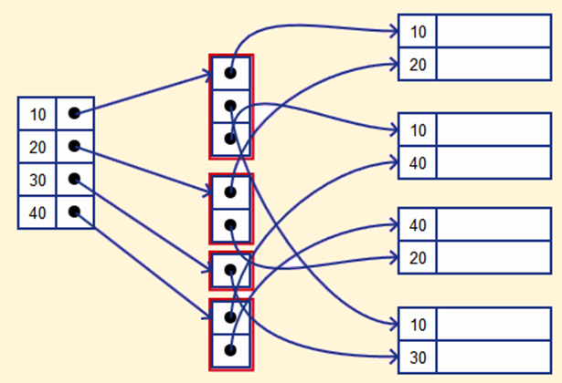
Example of Secondary Indexing
Let's understand secondary indexing with a database index example:
In a bank account database, data is stored sequentially by acc_no; you may want to find all accounts in of a specific branch of ABC bank.
Here, you can have a secondary index in DBMS for every search-key. Index record is a record point to a bucket that contains pointers to all the records with their specific search-key value.

Slide 39
Clustering Index
In a clustered index, records themselves are stored in the Index and not pointers. Sometimes the Index is created on non-primary key columns which might not be unique for each record. In such a situation, you can group two or more columns to get the unique values and create an index which is called clustered Index. This also helps you to identify the record faster.
Example:
Let's assume that a company recruited many employees in various departments. In this case, clustering indexing in DBMS should be created for all employees who belong to the same dept.
It is considered in a single cluster, and index points point to the cluster as a whole. Here, Department _no is a non-unique key.

Slide 40
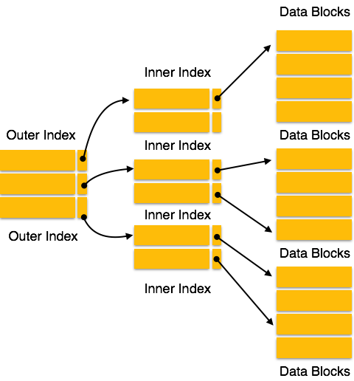
Multilevel Index
Multilevel Indexing in Database is created when a primary index does not fit in memory.
In this type of indexing method, you can reduce the number of disk accesses to short any record and kept on a disk as a sequential file and create a sparse base on that file.
Multi-level Index helps in breaking down the index into several smaller indices in order to make the outermost level so small that it can be saved in a single disk block, which can easily be accommodated anywhere in the main memory.

Slide 41
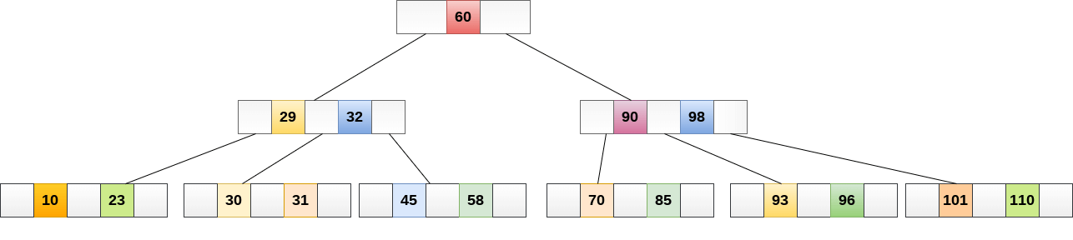
B Tree
B-tree index is the widely used data structures for tree based indexing in DBMS. It is a multilevel format of tree based indexing in DBMS technique which has balanced binary search trees. All leaf nodes of the B tree signify actual data pointers.
Moreover, all leaf nodes are interlinked with a link list, which allows a B tree to support both random and sequential access.

Slide 42
Advantages of Indexing
It helps you to reduce the total number of I/O operations needed to retrieve that data, so we don't need to access a row in the database from an index structure.
Offers Faster search and retrieval of data to users.
Indexing also helps you to reduce tablespace as we don't need to link to a row in a table, as there is no need to store the ROWID in the Index. Thus you will able to reduce the tablespace.

Slide 43
Disadvantages of Indexing
To perform the indexing database management system, you need a primary key on the table with a unique value.
We can't perform any other indexes in Database on the Indexed data.
We are not allowed to partition an index-organized table.
SQL Indexing decrease performance in INSERT, DELETE, and UPDATE query.

Slide 44
Multiple Key Access
So far we have seen sequential file organization and fetching of records based on the primary key or the column which is frequently used in the query. But in real life the query is not restricted to primary key or single column. It will have various needs to see the records in different combinations of columns. In such case indexes on primary/single column will degrade the performance of the query. Because the table will have huge number of records, and index on any one column will efficiently fetch all the records which satisfies the search criteria for indexed column. But the query is still not complete. It still has to filter the data with other search criteria on which we do not have index. What would be the result? This fetch becomes slow, in total reducing the cost of the query.

Slide 45
Multiple Key Access (Cont..)
For example consider employee table with huge number of employees in different department. Imagine we have to select all the employees whose salary is 5000 and works for department ID 20. Also, we have index created only on DEPT_ID. The query to select the records is as follows:
SELECT * FROM EMPLOYEE WHERE DEPT_ID = 20 and SALARY = 5000;
Since there is index on DEPT_ID, fetching all the employees who are working for department 20 is quick. But it will return large number of employees. Out of those employees, it has to filter the employees with salary = 5000. But this is same as querying a very big table with one search criteria. Hence this will be time consuming part of the query.
In real life situations, no one likes waiting and so is the case with query. We need to think of some better options than having index on single column/ primary keys.

Slide 46
Multiple Key Access (Cont..)
To handle above situation, multiple key accesses are introduced. Here, we use combination of two or more columns which are frequently queried to get index. In the above example, both DEPT_ID and SALARY are clubbed into one index and are stored in the files. Now what happens when we fire above query? It filters both DEPT_ID = 20 and SALARY = 5000 at a shot and returns the result.
This type of indexing works well when all the columns used in the index are involved in the query. In above example we have index on (DEPT_ID, SALARY) and both the columns are used in the query. Hence it resulted quickly.

Slide 47
Advantages of Multiple Key Access
It works efficiently when all the columns of the index is used in the query, provided it satisfies lexicographic ordering. Lexicographical order is a generalization of the alphabetical order of the dictionaries to sequences of ordered symbols.
It works efficiently even on larger tables. This is because, records are sorted based on the index.

Slide 48
Disadvantages of Multiple Key Access
It works only for lexicographic ordering.
It does not work efficiently if only one or partial columns of index are involved in querying. It does not use the index to retrieve the data.

Slide 49
Creating Index
The CREATE INDEX statement will create indexes in tables. Indexes are used for data procurement from the databases faster. The users cannot see the indexes, they are running in the background of queries.
Syntax:
Create an index on table
CREATE INDEX indexname ON tablename (columnname1, columnname2, ...);
Example:
CREATE INDEX idx_name ON Students (LastName);
To Create on multiple columns
CREATE INDEX idx_pname ON Students (LastName, FirstName);

Slide 50
Droping Index
The DROP INDEX statement could be used to remove an index from any table.
Syntax:
DROP INDEX tablename.indexname;
Example:
DROP INDEX Students.idx_pname;

Slide 51
Q&A

Slide 52
Thank You !!!

